Slide 1


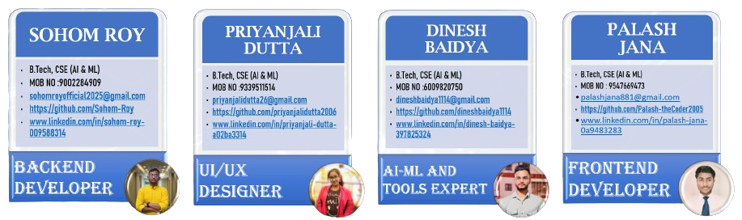
AI-Enhanced Career Guidance AND MONITORING System

Slide 2

The Career Confusion Crisis
Digital Distractions
Mismatched Careers
Generic Solutions
Youth aged 15-25 struggle with maintaining focus in our hyperconnected world, leading to poor decision-making in critical career choices.
Studies show 70% of students end up in careers that don't align with their skills or interests, creating widespread unemployment and underutilized potential.
Traditional career counseling lacks personalization, real-time monitoring, and AI-driven feasibility analysis that today's youth desperately need.

Slide 3
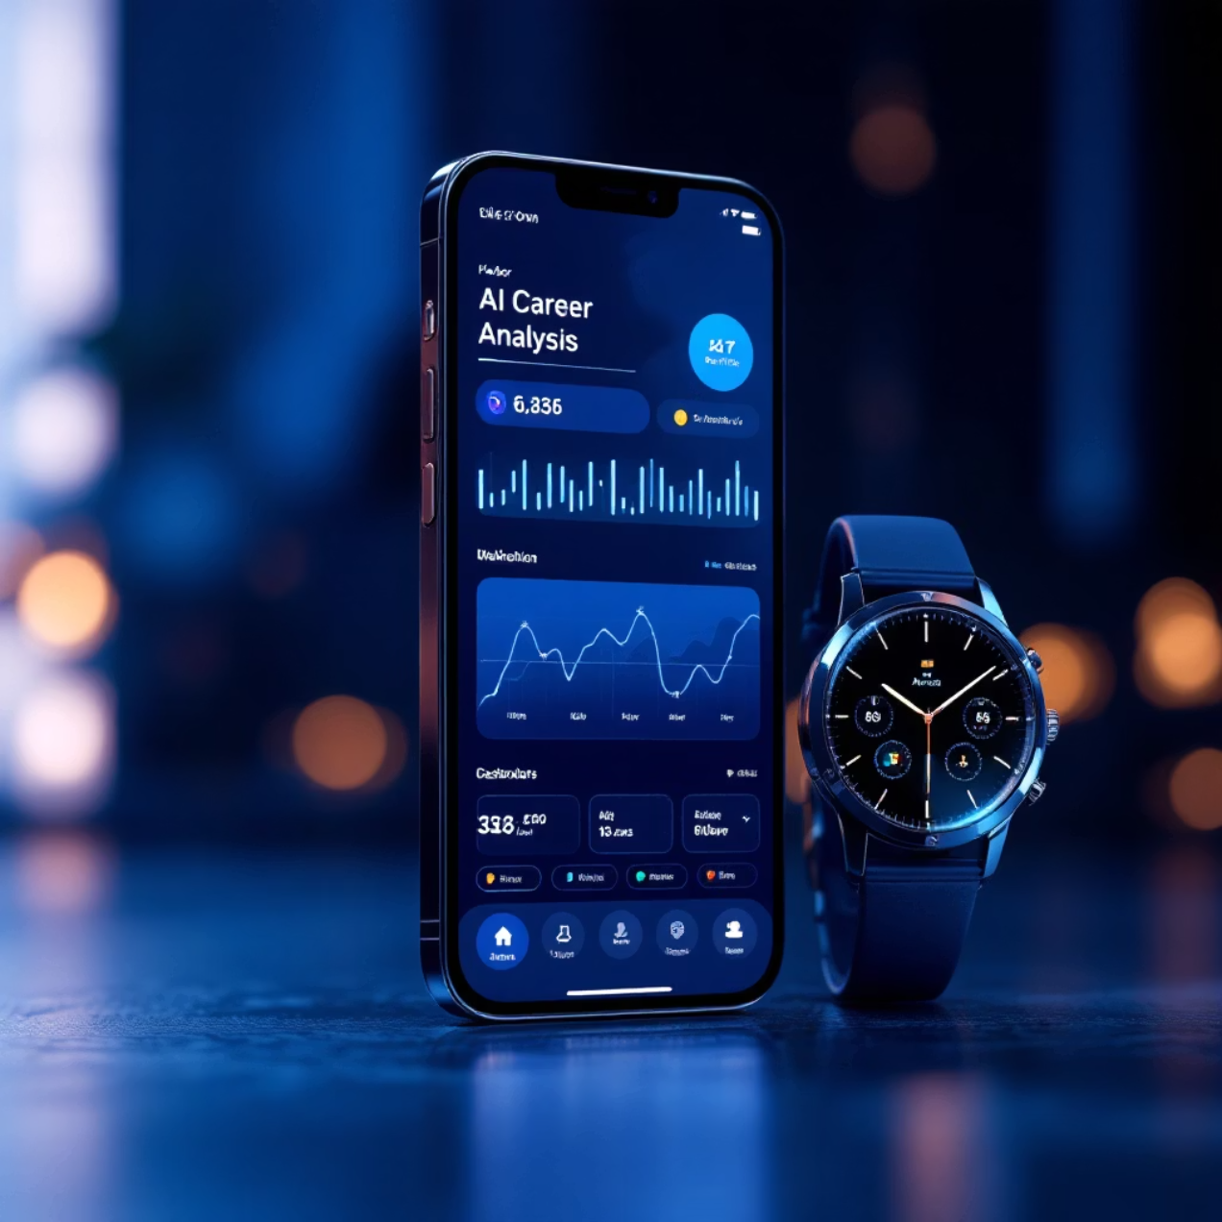
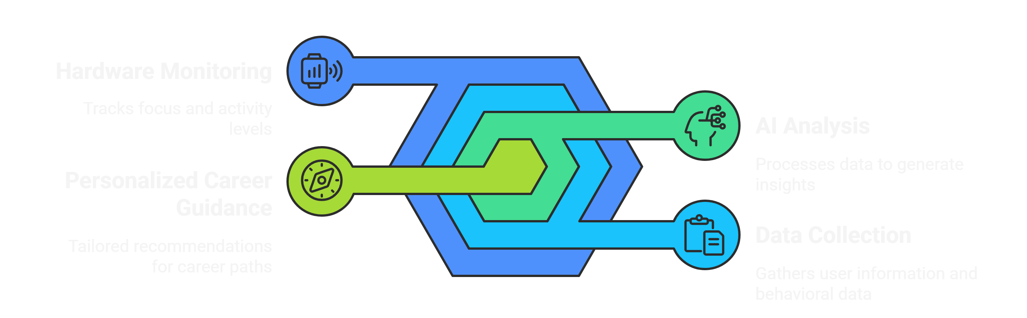
Our AI-Powered Guidance Platform
We've developed an innovative web and mobile application integrated with specialized hardware devices that revolutionizes career guidance for young people.
Our platform collects comprehensive user data including academic performance, personal interests, and psychometric assessments. Advanced AI and machine learning algorithms analyze this information using natural language processing to provide highly personalized career recommendations.
What sets us apart is our behavioral tracking capability through hardware monitoring, which ensures our suggestions are practically achievable based on real focus patterns and activities.

Slide 4




Clear Objectives and Vision
Immediate Goals
Collect and analyze comprehensive user data to deliver personalized career suggestions while monitoring real-world activities to ensure feasibility and alignment with individual capabilities.
Expected Outcomes
Significantly reduce career confusion by providing clear skill development roadmaps, relevant course recommendations, and targeted internship opportunities that match user focus patterns.
Long-Term Vision
Scale our platform globally for youth worldwide, integrating VR career simulations and predictive job market analytics to create the ultimate career guidance ecosystem.

Slide 5




Robust Tech Foundation
Backend Systems
Frontend Experience
Python with Flask framework powers our robust backend infrastructure, handling complex AI computations and user data processing with enterprise-grade reliability and scalability.
JavaScript with React creates an intuitive, responsive user interface that adapts seamlessly across devices, ensuring exceptional user experience on web and mobile platforms.
Hardware Integration
AI/ML Stack
C++ firmware on Arduino/ESP32 platforms enables real-time sensor data collection through Bluetooth and MQTT protocols, bridging physical activity with digital insights.
Scikit-learn for machine learning models, spaCy for natural language processing, and MySQL for secure data management, integrated with O*NET APIs for current industry trends.

Slide 6
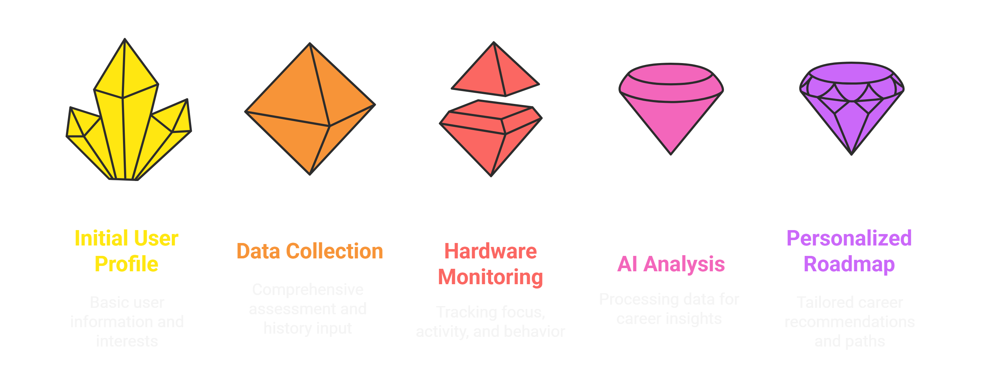
Seamless User Flow
01
02
03
User Registration
Data Collection
Hardware Monitoring
Simple onboarding process captures basic profile information and career interests through an intuitive interface designed for young users.
Comprehensive assessment through interactive forms, psychometric quizzes, and academic history input creates a detailed user profile foundation.
Wearable devices continuously track focus patterns, activity levels, and behavioral data to understand real-world user engagement and capabilities.
04
AI Analysis
Advanced machine learning algorithms process all collected data using NLP and behavioral analysis to generate personalized career insights and feasibility scores.
05
Personalized Roadmap
Dynamic dashboard presents tailored career recommendations, skill development paths, course suggestions, and internship opportunities with real-time progress tracking.

Slide 7
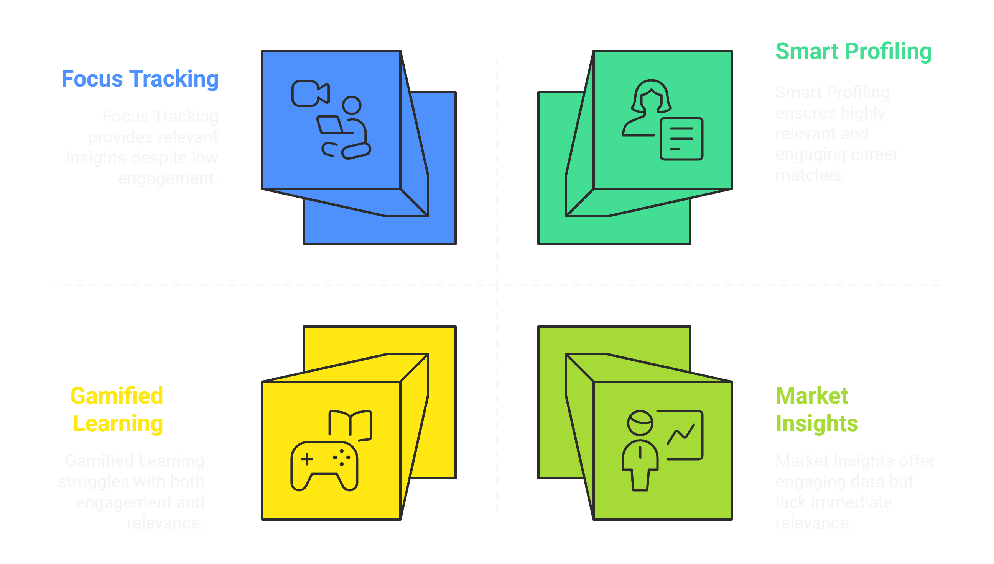
Standout Features

Slide 8

Phased Development Roadmap
1
Research & Planning
COMPLETED
Market analysis, user research, and technical architecture design. Foundation work completed with comprehensive requirement gathering and stakeholder interviews.
2
Prototype Development
70% COMPLETE
Core application build with hardware integration currently underway. Functional demo ready for presentation today showcasing key features and user workflow.
3
User Testing
IN PROGRESS
Pilot testing with select user groups to validate accuracy, privacy compliance, and user experience optimization based on real feedback.
4
Full Deployment
PLANNED
AWS cloud hosting setup, mobile app store release, and scaling infrastructure to support widespread adoption post-hackathon.

Slide 9
Anticipated Challenges
Challenge
Mitigation Strategy
Data Privacy Concerns
GDPR-compliant encryption, explicit user consent, and transparent data usage policies
Hardware Accuracy
Comprehensive sensor calibration with machine learning baselines and continuous accuracy validation
Algorithm Bias
Diverse training datasets, regular bias audits, and inclusive model development practices
Technical Demo Risks
Offline prototype backups and multiple connectivity options to ensure seamless demonstration
Our proactive risk management approach demonstrates our commitment to delivering a reliable, ethical, and scalable solution that prioritizes user trust and system integrity.

Slide 10

Transformative Impact
70%
85%
Global
Reduction in Career Mismatches
User Engagement Rate
Scalability Potential
Cloud-based architecture designed for worldwide deployment across diverse educational systems
Projected decrease in students entering unsuitable careers through our personalized guidance system
Expected sustained platform usage through gamification and real-time feedback mechanisms
"This system nurtures excellence and empowers the next generation to make informed career decisions. Join us in guiding youth toward their optimal futures!"
Thank you for your time. We're excited to answer your questions!
Team Debug_Dynamos | NexHack 1.0

